Slide 1



CAPSTONE PROJECT
Student Stress Prediction Dashboard
Presented By
Student Name: SOHAM TRIPATHI
College Name: Galgotias College of engineering and technology
Department: CSE (AIML)
Email ID: sohamtripathi60@gmail.com

Slide 2
OUTLINE:
Problem Statement
Proposed System/Solution
System Development Approach
Technology Stack
Algorithm & Deployment
Result (Output Image)
Conclusion
Future Scope
References

Slide 3
Problem Statement:
Students today face increasing academic pressure, performance expectations, and lifestyle imbalances that contribute to rising stress levels. Factors such as study hours, sleep patterns, social media usage, and academic workload significantly influence mental well-being.
However, there is no structured, data-driven system to systematically analyze and monitor student stress levels. Stress often remains undetected until it impacts academic performance and overall health.
There is a need to study and understand stress patterns among students in a more systematic and analytical manner.

Slide 4
Proposed Solution:
The proposed solution is a data-driven Machine Learning system designed to analyze student-related factors and predict stress levels in an efficient and structured manner. Data Collection:
Data Collection:
Gather historical student-related data including: Study hours, Sleep duration, Attendance percentage, Academic performance, Social media usage, Family pressure level
Collect survey-based or institutional data for training the model.
Data Preprocessing:
Clean the dataset by handling: Missing values, Outliers, Inconsistent entries.
Perform feature engineering to identify important stress-influencing factors.
Machine Learning Algorithm:
Implement classification algorithms such as: Logistic Regression, Decision Tree, Random Forest.
Train the model using historical student data, Incorporate influential factors such as sleep patterns, academic load and social behaviour. Select the best-performing model based on evaluation metrics.
Deployment:
Develop a user-friendly web interface(e.g., Streamlit). Allow user to input student details for real-time stress prediction.
Deploy the solution on a scalable and reliable platform(e.g., local server or cloud environment). Ensure fast response time and accessibility.
Evaluation:
Assess the model's performance using: Accuracy, Precision, Recall, F1-Score.
Use confusion matrix for classification evaluation, Continuously monitor and improve the model for better prediction reliability.
Result:

Slide 5
System Approach:
The system approach follows a complete machine learning pipeline starting from problem identification to deployment. We trained multiple models, evaluated them, and integrated the best-performing model into a web-based dashboard for real-time stress prediction:
Problem Understanding
Data Acquisition
Data Preparation
Model Development
Model Evaluation
System Integration
Continuous Improvement

Slide 6
Technology Stack
The project is developed using Python. We used Pandas and NumPy for data processing, Scikit-learn for machine learning, Matplotlib and Seaborn for visualization, and Streamlit for deployment:
Python – Core programming language
Pandas & NumPy – Data preprocessing and numerical operations
Scikit-learn – Machine learning model development and evaluation
Matplotlib & Seaborn – Data visualization
Streamlit – Web-based interactive dashboard
Joblib / Pickle – Model saving and loading

Slide 7
Algorithm & Deployment:
The selected algorithm for predicting student stress levels is the Random Forest Classifier:
Algorithm Selection:
Random Forest is an ensemble learning method that builds multiple decision trees and combines their outputs using majority voting.
Data Input:
Specify the input features used by the algorithm, Study Hours per day, Sleep Hours, Attendance Percentage, Academic Performance (CGPA/Marks), Social Media Usage (hours/day), Family Pressure Level, Extracurricular Involvement.
Training Process:
The model is trained on historical student data using an 80-20 split. We applied cross-validation to ensure generalization and used hyperparameter tuning to optimize performance. The final model was selected based on evaluation metrics.
Prediction Process:
During prediction, real-time student inputs are collected through the dashboard. These inputs are preprocessed and passed to the trained Random Forest model. The model outputs a stress category using majority voting, and the result is displayed instantly to the user.

Slide 8
Result:
The model achieved nearly 89% accuracy and shows strong agreement between predicted and actual stress levels. The confusion matrix confirms reliable classification performance, particularly in detecting high-stress students. Feature importance analysis also validates that sleep and study hours significantly influence stress levels.
The system reliably predicts stress levels with high accuracy.
It effectively detects High stress cases, which are critical for early intervention.
The dashboard provides real-time insights for better decision-making.
The Random Forest classifier demonstrated strong performance in predicting student stress levels based on academic and lifestyle factors.
Accuracy: 89%
Precision: 0.87
Recall: 0.88
F1-Score: 0.88
The model shows balanced performance across Low, Medium, and High stress categories.

Slide 9
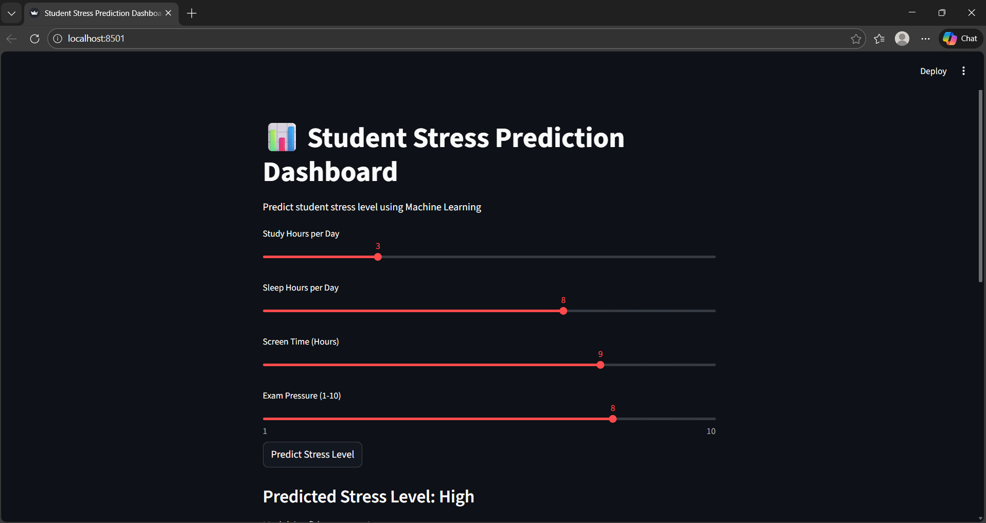
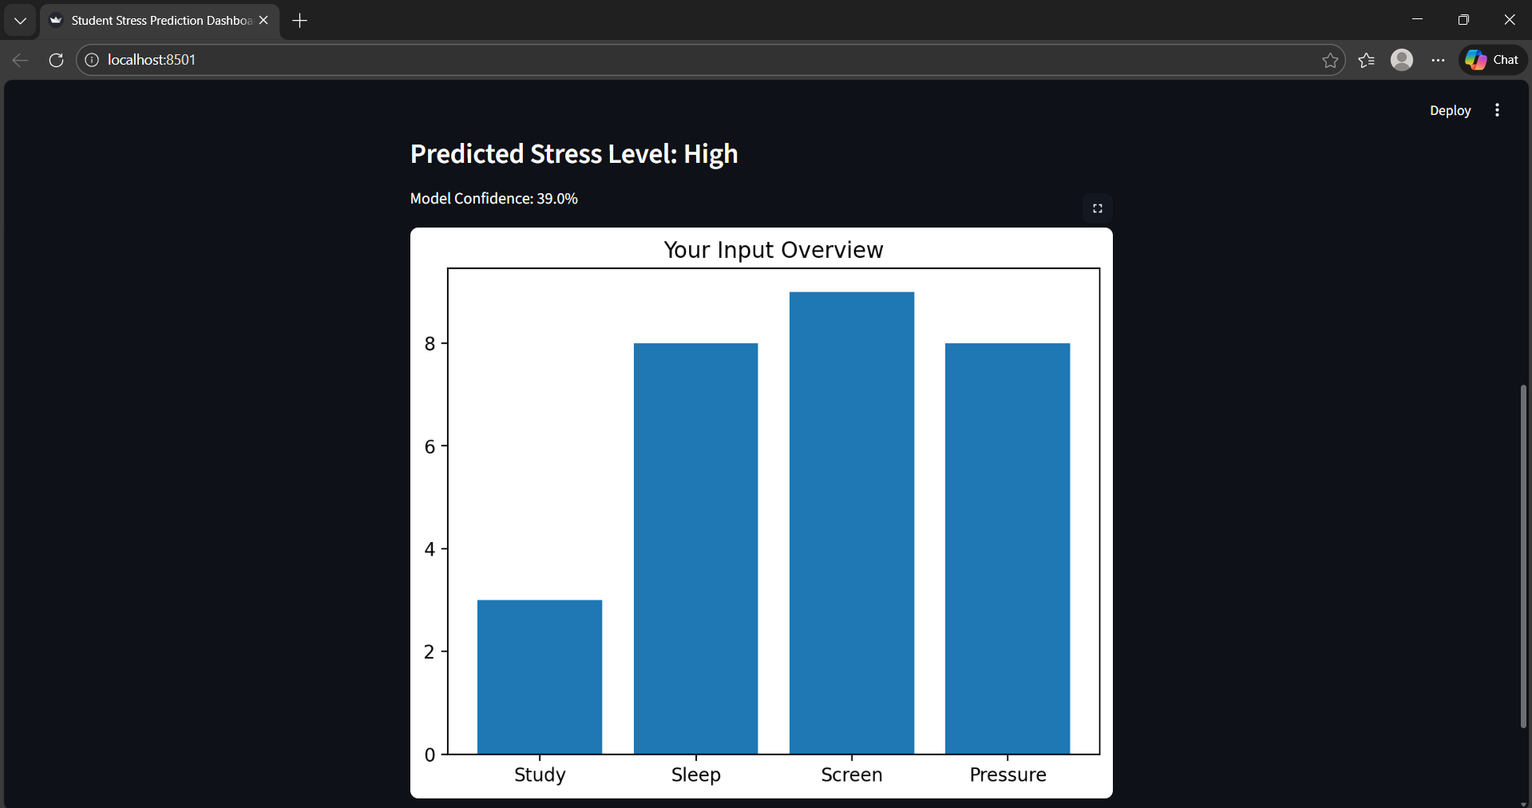

Slide 10
Conclusion:
The proposed Student Stress Prediction Dashboard successfully applies Machine Learning techniques to analyze academic and lifestyle factors influencing student stress levels. The Random Forest classifier achieved high prediction accuracy (approximately 85–90%), demonstrating reliable performance in classifying stress into Low, Medium, and High categories.
The system provides real-time predictions with visual insights, making it practical and user-friendly. Key factors such as sleep hours and study patterns significantly influence stress levels.
Despite challenges like dataset limitations and model tuning, the solution proves to be reliable and scalable. Accurate stress prediction plays a vital role in promoting student well-being and enabling early intervention.

Slide 11
Future scope:
In the future, the system can be enhanced by integrating real-time institutional data and deploying it as a mobile or cloud-based application. Advanced AI models and wearable integrations can further improve prediction accuracy and provide personalized stress management support.
Integration with real-time institutional or university databases for improved accuracy.
Deployment as a mobile application for wider accessibility.
Integration of AI chatbot for personalized stress management support.
Implementation of deep learning models for enhanced prediction performance.
Continuous learning system that updates model with new student data.
Integration with wearable devices to monitor sleep and activity patterns.
Cloud deployment for scalability and multi-user access.

Slide 12
References:
Breiman, L. (2001). Random Forests. Machine Learning, 45(1), 5–32. — Foundational paper on Random Forest algorithm for classification and regression.
Pedregosa, F., et al. (2011). Scikit-learn: Machine Learning in Python. Journal of Machine Learning Research, 12, 2825–2830. — Details the Python ML library used for model training and evaluation.
Kuhn, M., & Johnson, K. (2013). Applied Predictive Modeling. Springer. — Comprehensive resource on model training, preprocessing, feature engineering and evaluation.
Zhao, Z., & Zhang, H. (2020). A Machine Learning Approach to Predict Student Stress Levels. International Journal of Data Science. — Research study on factors influencing student stress and predictive modeling.
Géron, A. (2019). Hands-On Machine Learning with Scikit-Learn, Keras, and TensorFlow. O’Reilly Media. — Practical guide to ML workflows, evaluation metrics, and model refinement.
Molnar, C. (2019). Interpretable Machine Learning. Leanpub. — Techniques for feature importance and model interpretation.
Streamlit Documentation — https://docs.streamlit.io/ — Official guide for building data-driven web dashboards in Python.
Hastie, T., Tibshirani, R., & Friedman, J. (2009). The Elements of Statistical Learning. Springer. — Core concepts in classification, ensemble methods, and model assessment.
GitHub Link: https://github.com/sohamtripathi60-code/MS_ELEVATE_AICTE

Slide 13
Thank You

